Slide 1
SU26SE104_GSU48 • CAPSTONE PROJECT
Electronic Training Record (ETR)
Digitalizing Aviation Training Records Management
Group: SU2026-GSU-ETR
Team members
Nguyen Huu Nhat Trieu (SE170486) — Team Leader · Full-stack & Integration
Vo Trong Nhan (SE171411) — Front-end · QA Tester
Doan Trong Khoi (SE141053) — Back-end · Automation Tester
Tran Trong Nhan (SE171973) — Front-end · UI/UX & Integration Tester
Supervisor: Ngo Dang Ha An • Semester: Summer 2026

Slide 2
02
Agenda
The presentation follows the order the panel evaluates
01 Problem & Users
Current manual process, the key problems and the 7 stakeholder roles.
06 Live Demo
End-to-end lifecycle: enrol → train → assess → verify → approve → freeze.
02 Scope & Overall Results
68 use cases, what was delivered, and what is out of scope.
07 Testing & Quality
Test case counts, pass rate and how defects were handled.
03 System Architecture
One architecture diagram: React SPA → .NET API → Clean Architecture → SQL Server.
08 Team Roles & Contribution
Who did what, with the evidence behind it.
04 Technology Stack
Each chosen technology with the reason behind the choice.
09 Limitations & Future Work
Known limits stated up front, plus the roadmap.
05 Main Functions
Feature groups mapped to the use cases in the SRS.
Electronic Training Record (ETR) • SU26SE104_GSU48

Slide 3
03
Problem — Current State (As-Is)
Before any software: how aviation training records are managed today
Today the academy runs training records on paper forms, Excel sheets, scanned PDFs, shared folders and email — five different storage forms that are never linked together. There is no central system, no record status and no change history.
Records kept in many formats
The same training record exists as a paper form, an Excel row, a scanned PDF and an email attachment.
No single source of truth.
Spread across departments
Seven stakeholder roles (Academic Staff, Instructor, QA, Manager, Admin, Auditor, Learner) each hold their own copy.
Nothing is centralised or linked.
No status or version control
Verification and approval are coordinated manually; several versions of one document coexist.
Outdated files are used by mistake.
No systematic audit trail
Who changed or approved a record, and when, is not recorded anywhere consistently.
Audit evidence is assembled by hand.
Consequence: inconsistent, duplicated or missing data; slow verification and reporting; long manual preparation for CAA / EASA / FAA audits; and no reliable proof of a learner’s training history when it is needed most.
Electronic Training Record (ETR) • SU26SE104_GSU48

Slide 4
04
Problem — Key Issues & Impact
Each issue traced to the impact it creates for the academy
Problem / Risk | Description | Potential impact
Records lost or damaged | Paper records can be misplaced, damaged by fire or water, or deteriorate over time. | Training history cannot be proven; retention rules are breached; operations are affected.
No version control | Multiple versions of the same document exist in different places. | Outdated data is used; confusion during assessment checks.
Hard to search and retrieve | Finding an old record means manually reviewing several sources and folders. | Delays in reporting, verification and inspection support.
Compliance & audit risk | No recorded edit or approval history; records are scattered across departments and formats. | Record validity cannot be proven during audit; dossiers take a long time to compile.
Inconsistent data | The same information is re-entered on several forms and files. | Data discrepancies and inaccurate statistics.
Low data security | Paper records can be viewed or copied without authorisation. | Personal data leakage and breaches of data-security rules.
Why it matters: these are not only inefficiencies — in a regulated aviation environment they become compliance and safety risks. The ETR system was built to remove them.
Electronic Training Record (ETR) • SU26SE104_GSU48

Slide 5
05
Users — Stakeholders, Roles & Authorization
Seven roles, each with a defined responsibility and a defined boundary
Actor | Main responsibilities | Authorization
Administrator | Manage user accounts, roles and departments; system configuration; review audit logs. | Full system access; master-data management; administrative reopen of a locked ETR.
Academic Staff (Training Coordinator) | Learner profiles, courses, subjects, classes, enrolment; evidence; submit the ETR dossier. | Create / update training data; submit an ETR to QA. Cannot approve its own dossier.
Instructor | Record attendance, assessment scores and practical checklists; upload evidence; sign off subjects. | Write access limited to assigned classes and subjects only.
QA Staff | Verify or reject evidence; review submitted ETRs; return records for correction. | Approve / reject evidence and validate an ETR. Cannot verify evidence they uploaded themselves.
Training Manager | Final review and approval of verified ETRs; amendment and unlock decisions. | Approve and freeze an ETR; issue certificates; authorise score amendments.
Auditor (CAA) | Independent compliance review of locked records, approval history and audit logs. | Read-only: search, inspect and export training packages. No write operations.
Student (Learner) | View own ETR status, attendance, results, certificates and training history. | Read-only on official records; can maintain the personal profile and password.
Separation of duties: data entry, quality verification, final approval, system administration and independent audit are handled by different roles — enforced in code, not by convention.
Electronic Training Record (ETR) • SU26SE104_GSU48

Slide 6
06
Scope & Overall Results
What was registered, and what was actually delivered
68 / 68
Use cases registered → delivered (UC-01…UC-68)
35
Major features implemented (F-01…F-35)
7
User roles with role-based access control
235
Test cases executed, 100% passing
In scope — delivered
User, role and access management (RBAC)
Learner, course, subject and class management
Enrolment with automatic ETR generation
Attendance recording and rate calculation
Assessment, practical checklist and sign-off
Evidence upload, verification and version control
ETR submission, QA review, approval and Deep Freeze
Amendment / unlock workflow and retake history
Dashboards, notifications, audit trail and exports
Out of scope (stated exclusions)
Learning Management System / e-learning delivery
Online examinations and automated exam grading
Integration with external aviation authorities or airlines
Payment and training-fee management
Advanced / predictive analytics and AI
Multi-factor authentication and enterprise SSO
Native Android / iOS applications
Electronic Training Record (ETR) • SU26SE104_GSU48

Slide 7
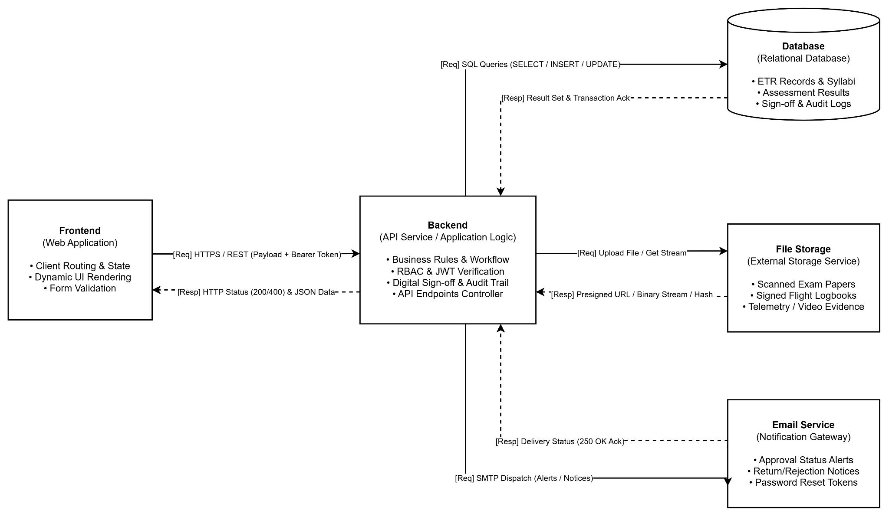
07
System Design / Architecture
Electronic Training Record (ETR) • SU26SE104_GSU48

Slide 8
08
Technology Stack
Not just a list — the reason each technology was chosen
Layer / purpose | Technology | Why we chose it
Frontend | React 19 + Vite 8, React Router 7, SCSS | Component-based SPA with fast builds; ApexCharts for dashboards and SheetJS for Excel export.
Backend | ASP.NET Core Web API | Strong REST tooling, EF Core, dependency injection and a clean layered structure.
Architecture | Clean Architecture — API / Application / Domain / Infrastructure | Keeps business rules independent and testable; framework changes stay in the outer layer.
Database | SQL Server (Azure SQL) | Relational and transactional; constraints and reporting suit compliance records.
Authentication | JWT + BCrypt password hashing | Stateless authentication with role-based (zero-trust) checks on every request.
File storage | Cloudinary | Evidence files are stored off-site with integrity hashing; the database keeps only metadata.
Documents & mail | QuestPDF, ClosedXML, MailKit (SMTP) | PDF certificates and Excel reports generated server-side; automatic email notifications.
Testing | xUnit + Moq (backend), Vitest (frontend), Postman/Swagger (API) | Automated verification of business rules plus API contract and UI testing.
Deployment | Azure App Service + Azure SQL + Vercel | Cloud hosting with continuous delivery and separate frontend/backend releases.
Electronic Training Record (ETR) • SU26SE104_GSU48

Slide 9
09
Main Functions (1/2)
Feature groups mapped to the use cases defined in the SRS
Feature group | Core functions | Use cases | Primary actor
System administration | Account, role and department management; audit log; system statistics | UC-48 → UC-55 | Administrator
Learner & curriculum | Learner records, courses, subjects, classes, enrolment, retake carry-over | UC-02 → UC-09 | Academic Staff
ETR lifecycle | Auto-generate ETR on enrolment, 4 compliance gates, submit to QA | UC-07, UC-13, UC-14 | Academic Staff
Attendance & assessment | Mark attendance, finalise session, record scores, practical checklist, sign-off | UC-17 → UC-21 | Instructor
Evidence & QA verification | Upload / verify / reject evidence, maker-checker rule, review queue, return for correction | UC-22, UC-29 → UC-33 | Instructor · QA Staff
Approval & locking | Final approval, Deep Freeze, certificate issue, amendment / unlock | UC-38 → UC-47 | Training Manager
Audit, search & export | Locked-ETR archive, advanced search, approval chain, ZIP/PDF packages | UC-62 → UC-68 | Auditor
Dashboards & self-service | Role dashboards, learner progress, certificates, notifications | UC-01, UC-15, UC-56 → UC-61 | All roles
Electronic Training Record (ETR) • SU26SE104_GSU48

Slide 10
10
Flow 1 - User & Access Management
Role: Administrator
Account Creation
Role-Based Access Control (RBAC)
Manage and Update User
Activity Oversight (Audit Log)
Electronic Training Record (ETR) • SU26SE104_GSU48

Slide 11
12
Flow 2 - Learner, Course & Enrollment
Role: Academic Staff
Enrollment Academic staff initiates learner enrollment into a specific class.
Auto-Generation
System automatically provisions the ETR Course Record in 'Draft' state.
Curriculum & Schedule Mapping : Auto-binds course subjects, passing score snapshots, and attendance rosters.
Ensuring Completeness
Guarantees no missing records by automating the foundational data setup.
Electronic Training Record (ETR) • SU26SE104_GSU48

Slide 12
13
Flow 3 - Attendance & Assessment
Role: Instructor
Data Isolation
Instructors can only access and modify data for classes they are explicitly assigned to teach.
Attendance Tracking
Real-time session confirmation and presence marking.
Automated Grading
System automatically calculates attendance rates and evaluates Pass/Fail status against configured thresholds.
Input Validation
Backend constraints reject invalid score inputs immediately.
Electronic Training Record (ETR) • SU26SE104_GSU48

Slide 13
14
Flow 4 - Evidence & QA Verification
Role: QA Staff
Maker-Checker Compliance
Document Upload
Instructors upload physical evidence (scans/PDFs) linked to specific training events.
Independent Verification
QA staff review pending evidence in a dedicated queue.
Strict Enforcement
System strictly prohibits users from verifying documents they uploaded themselves.
Audit Readiness
Ensures all training data is backed by verified physical or digital proofs.
Electronic Training Record (ETR) • SU26SE104_GSU48

Slide 14
15
Flow 5 - ETR Approval & Freeze
Role: Training Manager
The Deep Freeze Mechanism
Final Authority
Training Manager reviews fully verified ETRs for final sign-off.
Pre-Validation Engine
System checks all prerequisites (attendance, passing scores, verified evidence) before allowing approval.
Immutability Lock
Upon approval, the ETR enters the 'Completed' state.
Data Integrity
The 'Deep Freeze' prevents any further modifications by any user, ensuring regulatory compliance.
Electronic Training Record (ETR) • SU26SE104_GSU48

Slide 15
16
Flow 6 - Reporting, Export & Audit
Role: Auditor / Admin
Traceability & CAA Compliance
Automated Audit Trails
Entity Framework Interceptors automatically log every create, update, and delete action across the system.
Immutable Logs
Audit entries record user, action, timestamp, and data changes, and cannot be altered.
Package Generation
One-click compilation of the entire Training Package (PDF/ZIP) for completed ETRs.
Regulatory Readiness
Streamlines the preparation process for external Civil Aviation Authority (CAA) audits.
Electronic Training Record (ETR) • SU26SE104_GSU48

Slide 16
11
Testing & Quality
235 test cases across two levels, three execution rounds
235
Total test cases (129 unit + 106 system)
100.0%
Pass rate — 235 of 235 passed
0
Defects open at release
31 / 27
Service functions / features covered
Unit testing (white-box)
xUnit + Moq, Arrange-Act-Assert. 129 cases covering 31 service functions — Normal 40 (31.0%), Abnormal 64 (49.6%), Boundary 25 (19.4%).
System & integration testing (black-box)
106 cases across 27 features / controllers, executed in 3 rounds: Round 1 defect detection → Round 2 fix & re-test → Round 3 regression verification.
Security & RBAC testing
Cross-role checks: an Instructor cannot verify evidence, Academic Staff cannot approve an ETR, Auditor has read-only access and no write operation succeeds.
Defect handling
Defects found in Round 1 were logged in GitHub Issues with severity, then fixed and re-tested in Rounds 2–3. No defect remains open at release (defect log — Report 5).
Quality gates vs. plan
Planned defect ceilings: unit ≤ 2%, integration ≤ 4%, system ≤ 5%, acceptance ≤ 3%. All gate criteria were met before deployment.
Tools & environment
Swagger / Postman for API, Vitest for frontend, Chrome & Edge for cross-browser checks; automated rollback on the SQL Server test database.
Electronic Training Record (ETR) • SU26SE104_GSU48

Slide 17
12
Team Roles & Contribution
Who did what — with the evidence behind each claim
Member (role) | Main contribution | Evidence / deliverables
Nguyen Huu Nhat Trieu (SE170486) Team Leader · Full-stack · Test Manager | Requirements analysis and SRS baseline; system architecture; core ETR workflow (validation, submission, approval, locking); test management and UAT. | Report 3 (SRS), Report 4 (SDD), backend repository, test plan & UAT evidence.
Vo Trong Nhan (SE171411) Front-end · QA Tester | QA and dashboard screens; manual cross-browser testing on Chrome/Edge; defect logging and verification between Rounds 1–2. | Report 6 (user guides), Report 5 test report, frontend repository.
Doan Trong Khoi (SE141053) Back-end · Automation Tester | Backend services and EF Core data access; backend unit tests and API integration tests. | Backend repository, Report5_Unit Test — 129 unit test cases.
Tran Trong Nhan (SE171973) Front-end · UI/UX & Integration Tester | UI/UX prototype; student and auditor screens; API contract checks, Cloudinary upload payloads and Excel import dry-run validation. | UI/UX prototype, Report 6 screens/walkthroughs, Report 5 integration evidence.
All members | Document reviews (R/D responsibility matrix), weekly sprints, code reviews on every pull request and demo rehearsals. | Reports 1–7, GitHub pull-request history, weekly status reports.
Work was split in 1–2 week sprints with no single-owner critical task; frontend and backend were developed in parallel against a documented API contract.
Electronic Training Record (ETR) • SU26SE104_GSU48

Slide 18
13
Limitations & Future Work
We state the limitations before the panel has to point them out
Limitations (current scope)
Web-based only — a stable network connection and service availability are required.
Legacy paper / Excel records are not migrated automatically; migration must be a controlled import.
Learner access is read-only on official records — learners cannot create, verify or approve them.
Data accuracy depends on correct data entry by staff and on evidence verification.
No LMS / e-learning delivery is provided by the system.
No integration with external aviation authorities, airlines or third-party platforms.
No native mobile application; no multi-factor authentication yet.
Future development
Mobile application (Android / iOS) for instructors and learners.
LMS and online-examination integration.
Direct integration with CAA / airline training systems.
Advanced analytics and AI-based recommendations (e.g. at-risk learner prediction).
Automated legacy-data migration tooling.
Multi-factor authentication and enterprise SSO.
Offline evidence capture for flight-line and simulator environments.
Electronic Training Record (ETR) • SU26SE104_GSU48

Slide 19
Conclusion
A centralized, traceable and compliant training-record platform — built and verified end to end
68
Use cases delivered
35
Major features
7
Roles with RBAC
235
Test cases, 100% pass
Electronic Training Record (ETR) — SU26SE104_GSU48
Thank you. We welcome your questions and feedback.
Group SU2026-GSU-ETR · Nguyen Huu Nhat Trieu · Vo Trong Nhan · Doan Trong Khoi · Tran Trong Nhan · Supervisor: Ngo Dang Ha An
Q & A

